Slide 1
EDCI 337 Blog #6

Slide 2
Table of Content
SAMR
TPACK
SECTIONS

Slide 3
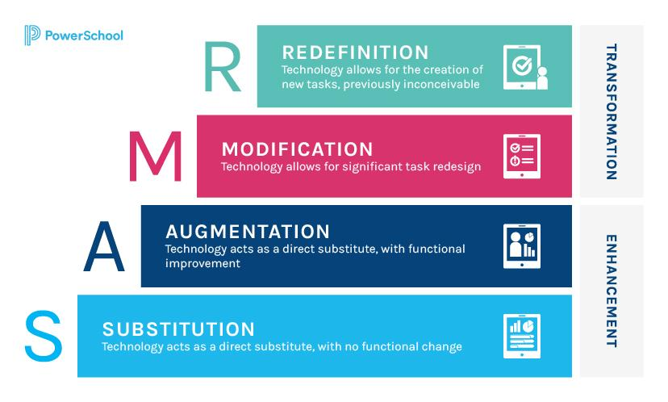
SAMR
Definition
Help teacher incorporate technology into their curriculum

Slide 4
SAMR
Goal
Incorporate technology into the classroom
Flow
Linear model
Focus
Continuously evolve the technology

Slide 5
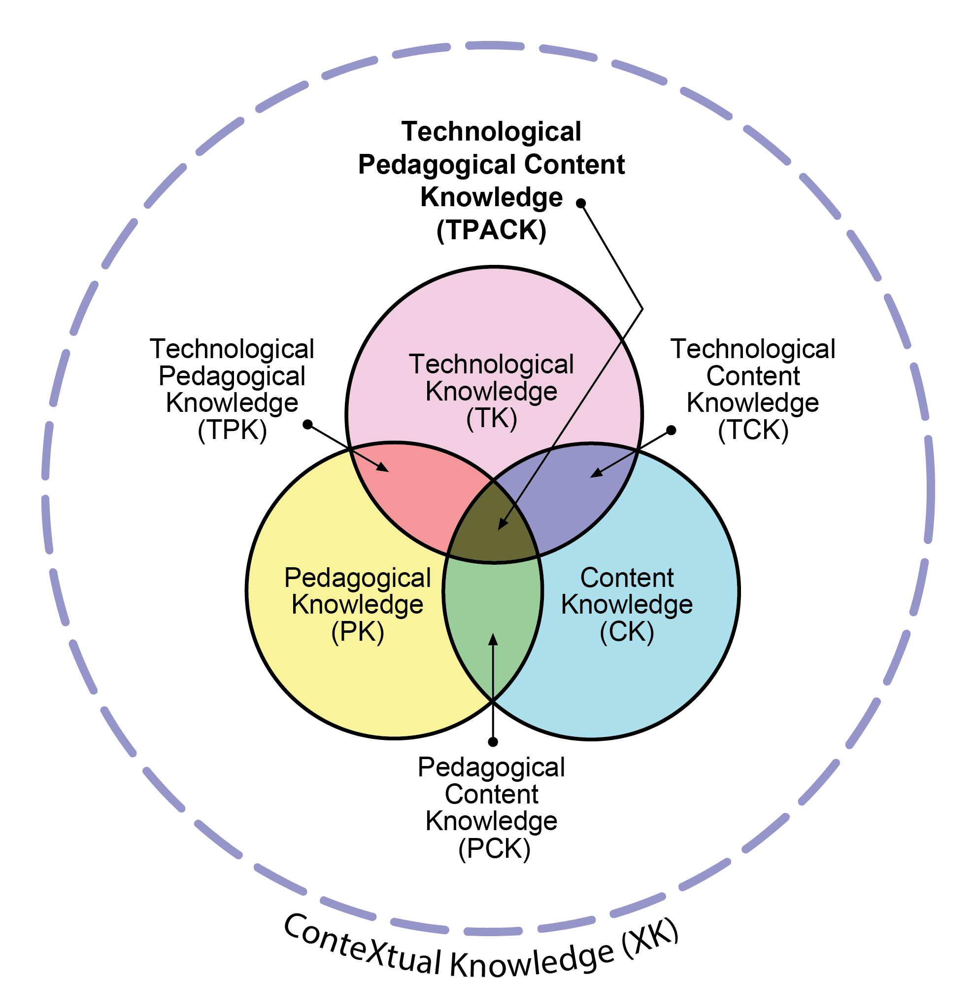
TPACK
knowledge that teachers need to teach their students a subject, teach effectively, and use technology

Slide 6
TPACK
Goal
Knowledge required to incorporate technology in the classroom
Flow
Each section works together
Focus
Meaningful knowledge

Slide 7
SECTIONS
what a technology is able to provide and it’s limitations.

Slide 8
SECTIONS
Goal
Evaluate the technology
Flow
Separately
Focus
Understand the technology within a given context

Slide 9
Conclusion
SAMR, PTACK, and SECTION all incorporate technology into their theory.
The overall focus around each theory differs

Slide 10
Citation
Messer, A. r. (2014, November 9). Tpack or Samr. Mr. Messer Teacher Blog. Retrieved October 25, 2021, from https://aaronmesserteaches.wordpress.com/2014/11/09/tpack-or-samr/.
SAMR Model: A Practical Guide for K-12 Classroom Technology Integration. Powerschool.com. (2021, April 13). Retrieved October 25, 2021, from https://www.powerschool.com/resources/blog/samr-model-a-practical-guide-for-k-12-classroom-technology-integration/.
Kurt, S. (2019, September 16). TPACK: Technological Pedagogical Content Knowledge Framework. Educational Technology. Retrieved October 25, 2021, from https://educationaltechnology.net/technological-pedagogical-content-knowledge-tpack-framework/.

